Slide 1

Medify

Slide 2
Login and Signup
Login
Signup
Existing users can log in with their email and password to access their account.
New users can create an account by providing their email, password, and other required information.

Slide 3
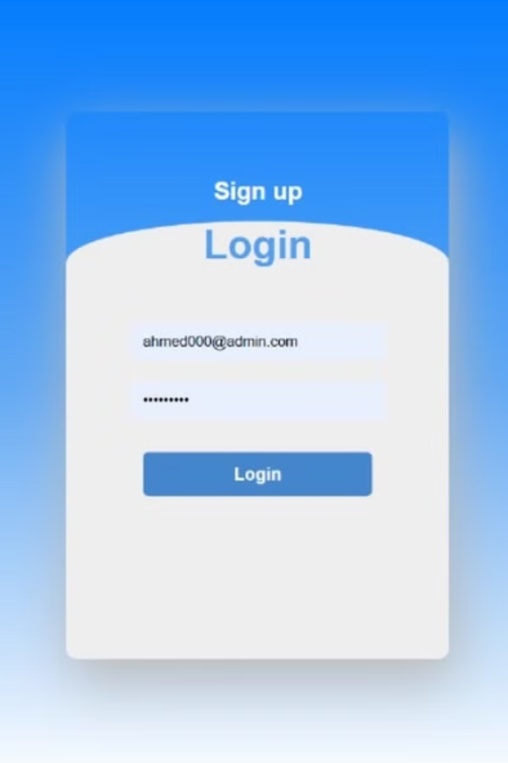


Differentiate User and Admin
User
Admin
Users can access services like booking appointments and viewing doctor profiles.
Admins have access to more features, such as adding, editing, and removing doctors.

Slide 4
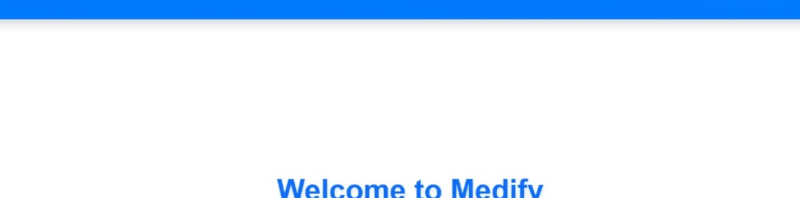
normal user page
Doctor List
Appointments
Users can browse available doctors by specialty, location, and availability.
Users can book appointments with available doctors through the system.
Feedback
Location
Users can provide feedback on their experience with the hospital or individual doctors.
Users can find the hospital's location and directions.

Slide 5

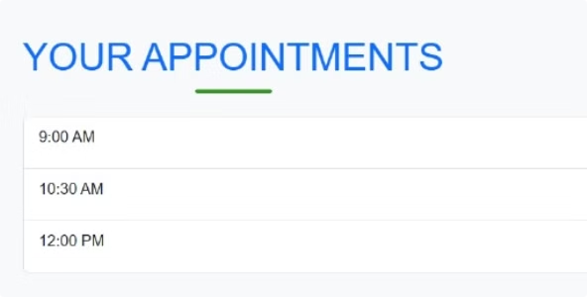
Doctor List and Appointments
Doctor Name
Specialty
Availability
Dr. Smith
Cardiology
Available Tuesday 2pm
Dr. Jones
Pediatrics
Available Wednesday 10am

Slide 6
User Feedback and Hospital Location
Feedback
Location
Users can leave comments and ratings for their doctor or the hospital.
The system provides a map with directions to the hospital.

Slide 7


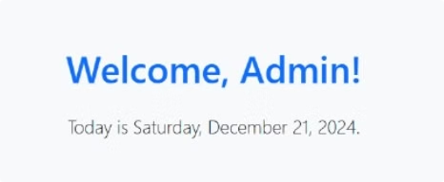


Admin's Main Page
Doctor Management
Admins can add, edit, or remove doctors from the system.
Appointment Management
Admins can view all appointments and manage scheduling.
Report Generation
Admins can generate reports on doctor performance and patient satisfaction.

Slide 8
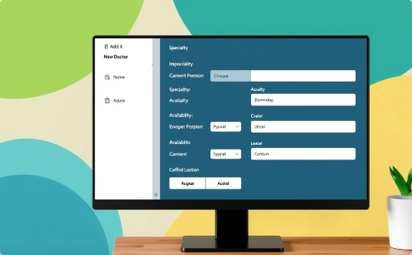
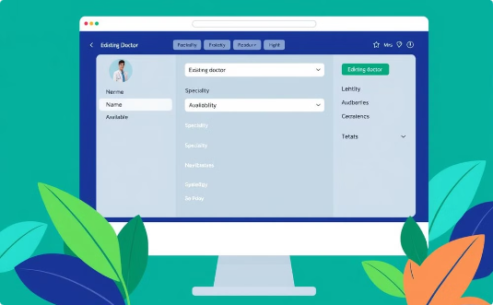
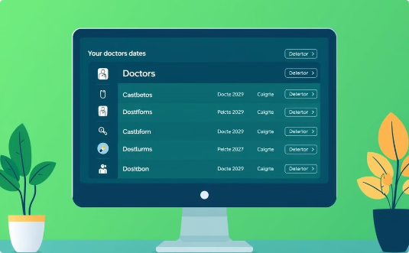
Add, Edit, and Remove Doctors
Add Doctor
Edit Doctor
Remove Doctor
Admins can add new doctors by filling out a form with their information.
Admins can edit existing doctor profiles by updating their information.
Admins can remove doctors from the system if they are no longer employed.

